Slide 1

Project 6:
Health Insurance objectives
Objectives:
1. Exploratory Data Analysis and Data Visualization
2. Hypothesis Testing
Hypotheses:
- People who smoke tend to have a higher insurance than people who don't smoke.
- Insurance is typically higher when an individual has more than one attribute associated with smoking.
- People over the age of 40 have a higher insurance than people below 40 years old.

Slide 2
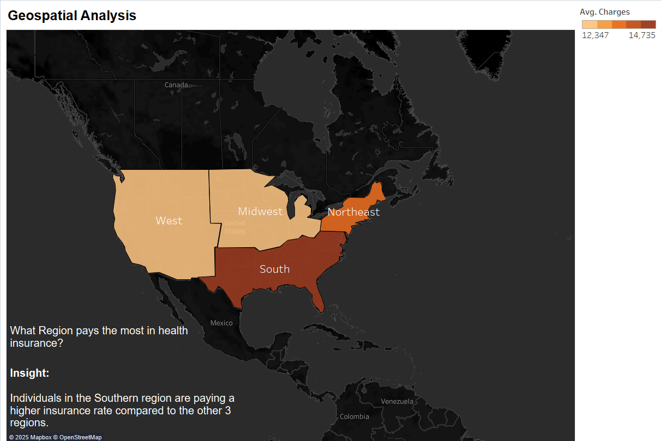

Slide 3
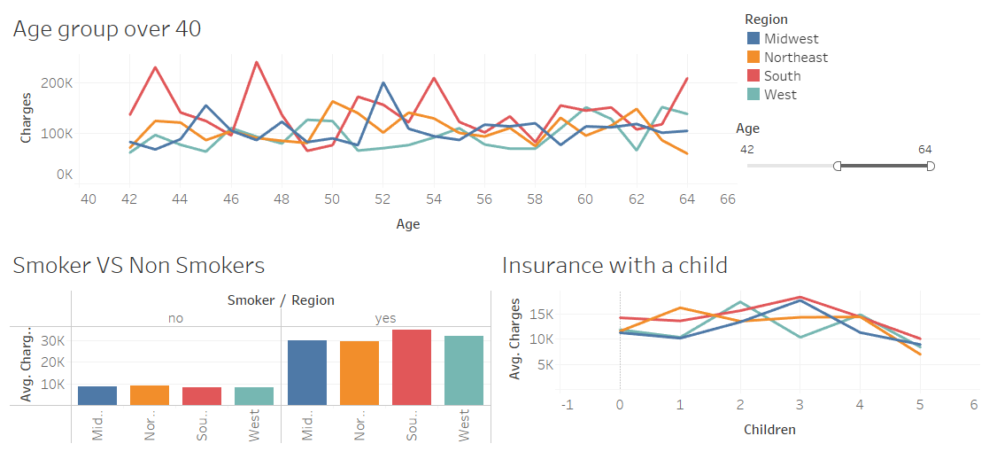
Health Insurance Analysis
Insight:
The Southern region has the 3 attributes the are the effect of having the highest insurance average.
The Southern region has more individuals who smoke compared to none smokers.
The Southern region pays more for insurance when they have more than 2 kids.
- The Southern region on average has more individuals over 40 years old paying higher insurance

Slide 4
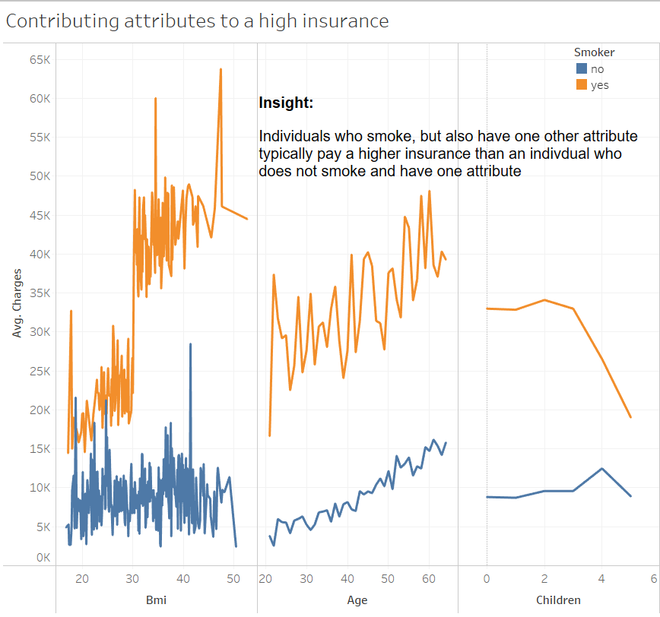
Health Insurance Analysis

Slide 5
Health Insurance Recommendations
Key takeaways
- Smoking Impact on Charges: There is a significant difference in charges between smokers and non-smokers. Smokers tend to have higher insurance costs, which aligns with health risks associated with smoking.
- Age vs. Charges: Older individuals generally have higher insurance costs, indicating a correlation between age and healthcare expenses.
- BMI and Charges: Higher BMI values seem to increase the insurance charges, suggesting a link between obesity and medical expenses.
- Regional Distribution: The dataset does not show any extreme variations in insurance charges across different regions, suggesting that location does not significantly impact costs.
Targeted Premium Adjustments for Smokers:
Since smokers tend to face higher charges due to health risks, insurers could consider offering smoking cessation programs as incentives for policyholders.
Age-Based Premium Structuring:
Given the clear correlation between age and higher charges, insurance companies could refine their pricing models by introducing more age-segmented policies. For example, providing coverage packages that cater specifically to seniors, could improve customer satisfaction.
BMI-Related Premium Adjustments:
- Insurers may want to consider introducing programs to encourage healthy living, such as weight-loss challenges or wellness programs. They could offer reduced premiums for individuals who participate.

